Slide 1
LECTURE 6

Slide 2

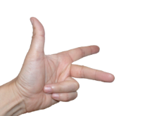
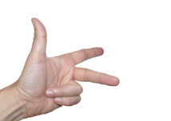
Q.
Name the following diagrams and explain the concept behind them.
Thumb
Thumb
foreFinger
foreFinger
Middle finger
Middle finger
Fleming’s Right Hand Rule
Fleming’s Left Hand Rule
Stretch the thumb, the forefinger and the middle finger of your right hand in such a way that they will be perpendicular to each other.
Stretch the thumb, the forefinger and the middle finger of your left hand in such a way that they will be perpendicular to each other.
If the thumb is in the direction of motion of the conductor, the forefinger is in the direction of the magnetic field, then the middle finger shows the direction of the induced current.
If the forefinger is in the direction of the magnetic field, and the middle finger is in the direction of the current then the thumb shows the direction of the force on the conductor.
It is used to find direction of force on the conductor.
It is used to find direction of induced current.

Slide 3

Difference between AC generator and DC motor
AC generator
DC motor
1
1
It converts mechanical
energy into electrical energy.
It converts electrical energy into
mechanical energy
2
2
Works on the principle of force acting on a current carrying conductor placed in a magnetic field.
Works on the principle of electro-magnetic induction.
3
Current from a d.c. source flows in the coil placed in a magnetic field due to which the coil rotates.
3
Coil is rotated in a magnetic field so as to produce electric current
4
Makes use of two separate coaxial slip rings.
4
Makes use of two split rings.

Slide 4
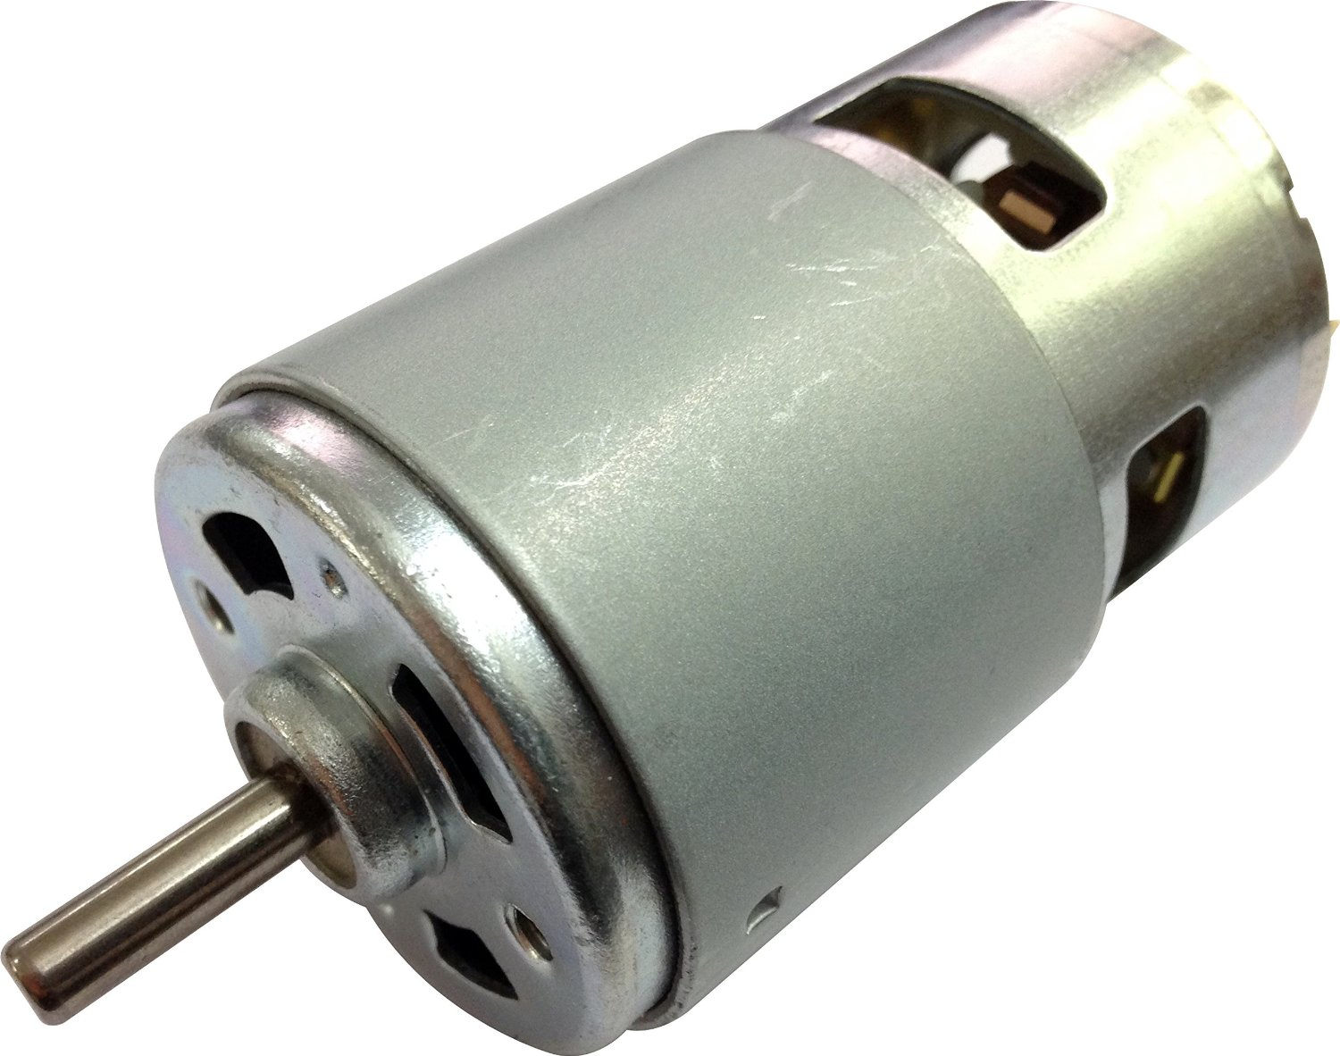
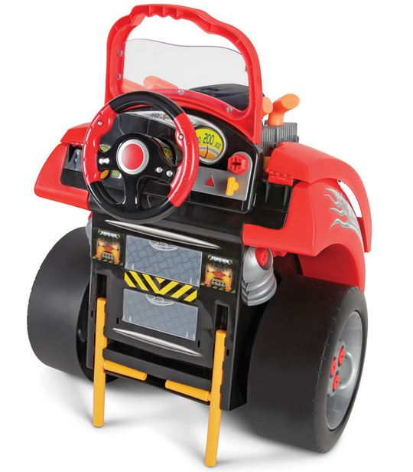

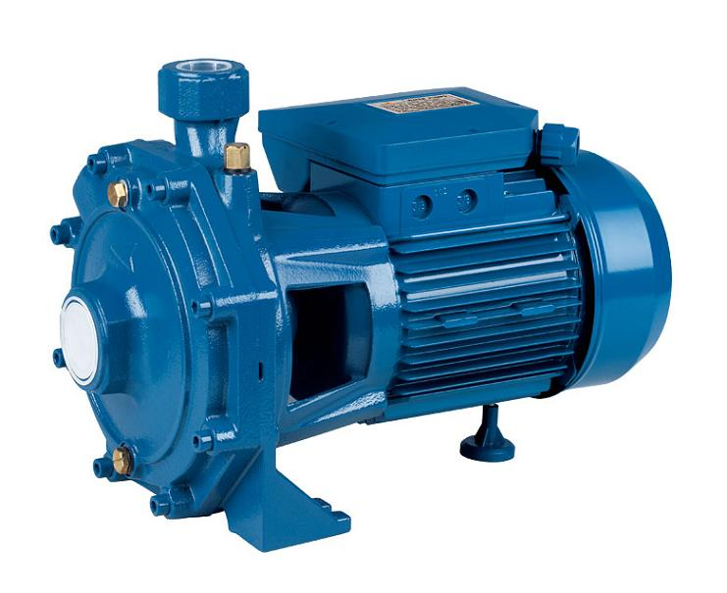
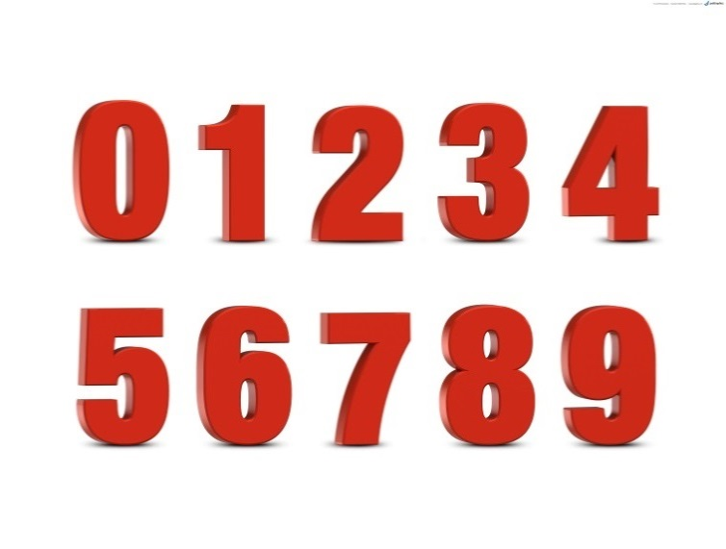


D.C. Motor
Applications of a D.C. Motor:
Ways of increasing speed of rotation of the Coil
Toys
Increase the number of turns in the coil
Water pumps
Increasing the area of cross section of the coil
Motorcycles
Increasing the speed of
rotation of the coil.

Slide 5
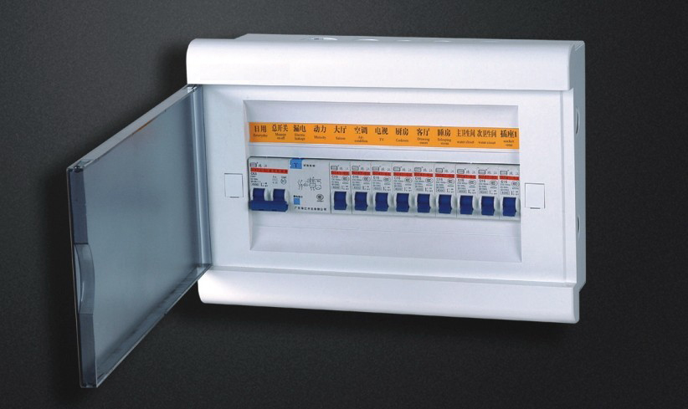
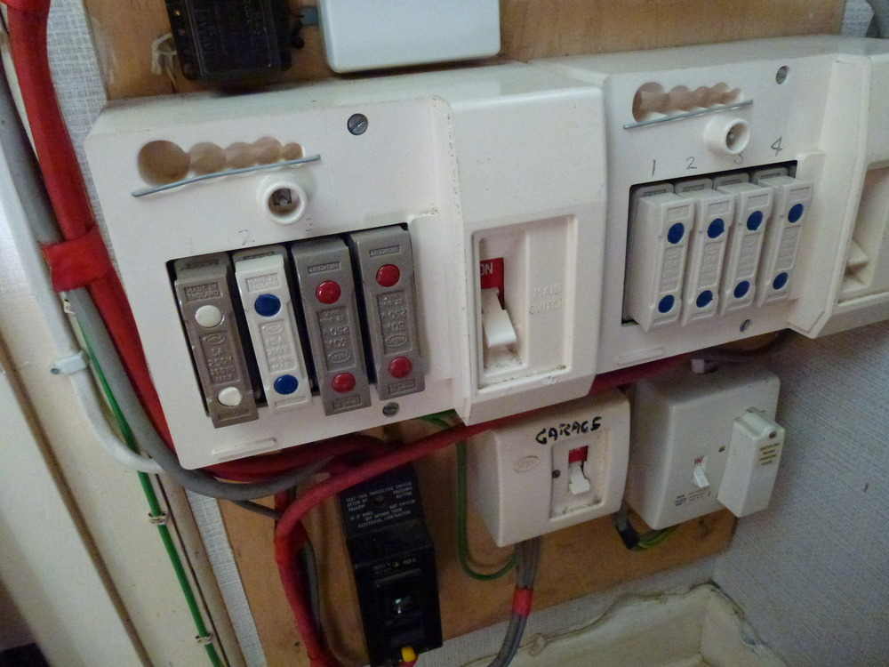
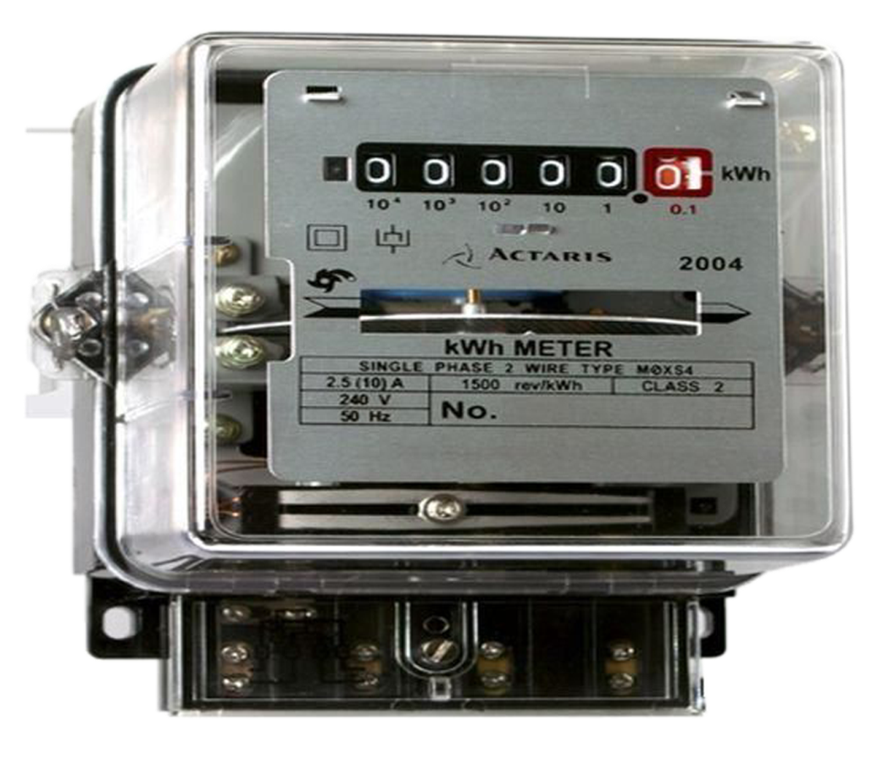
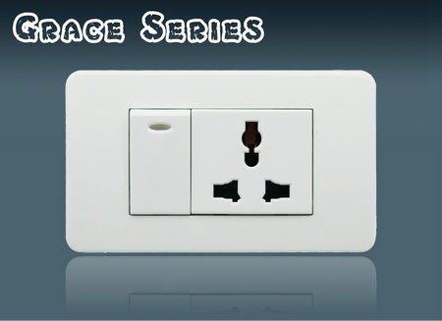
DOMESTIC ELECTRIC CIRCUIT
Live wire is also called as phase wire
The potential difference between the live wire and neutral wire is 220V – 250V
Earth wire
Earthing - which is mostly green wire
Live wire
220V
Neutral wire
Electricity
board’s fuse
Electricity
meter
Neutral - which is mostly black wire
5A rating for bulbs, fan etc.
Connection is further given to a distribution box in the house
Live - which is mostly red wire
From fuse, wire goes to electricity meter.
Often two separate circuits are used
Distribution box
containing main
switch and fuses for each circuit
From main supply electricity connection is given to fuse
15A current rating for appliances with higher power rating

Slide 6
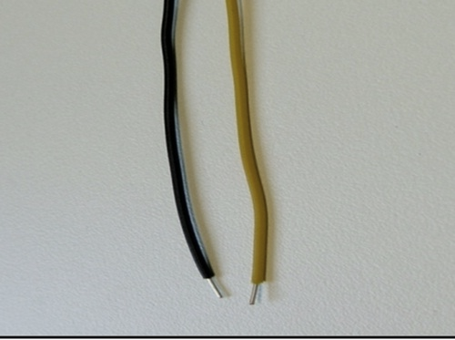

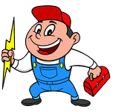
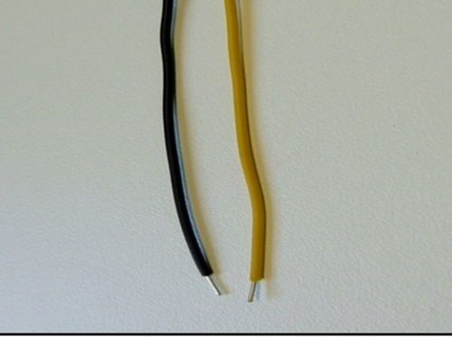
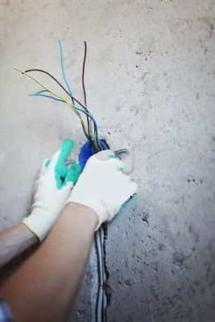
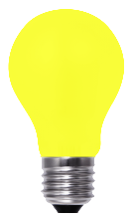
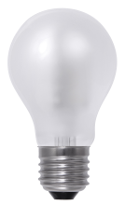
Short circuit
Resistance → less
Neutral wire
Live wire
Current → High
High current can cause sparking and fire.

Slide 7



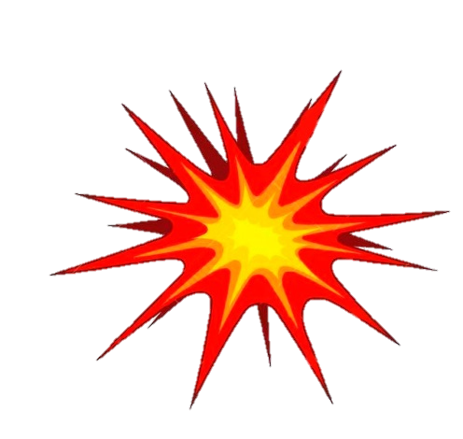
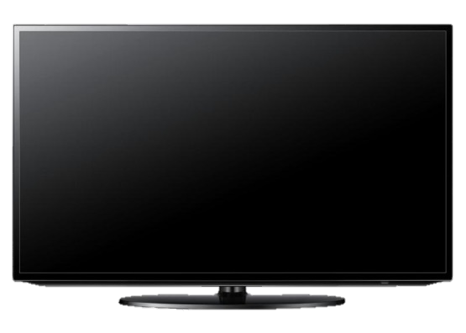
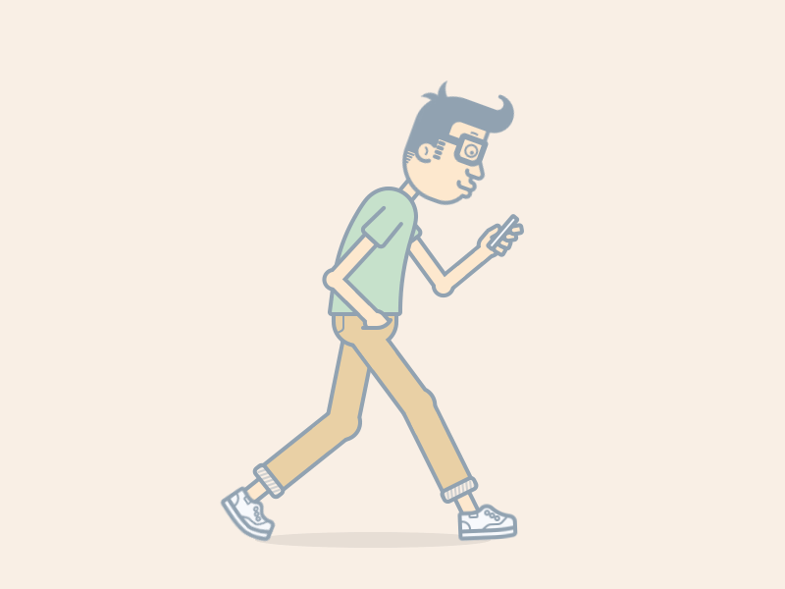
MAIN SUPPLY
ELECTRIC FUSE
An electric fuse protects circuits and appliances by stopping the flow of excess current.
Short - circuit
Domestic voltage in our house is around 220 V – 240 V
(very large amount of current flows)
230 V supply
Wire of Lead and Tin
Appliance is protected from damage
(Low Melting Point)
Wire melts
Circuit is broken
Porcelain Body

Slide 8
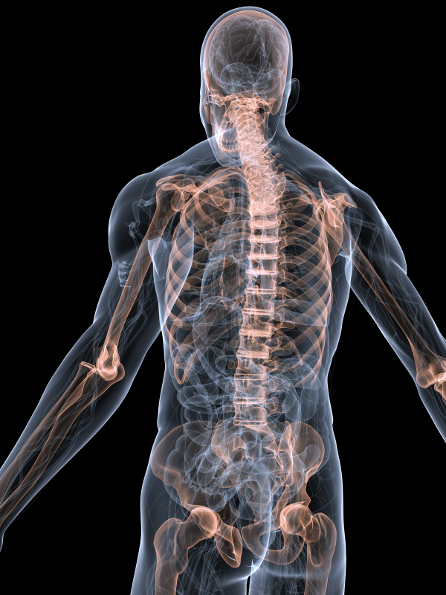
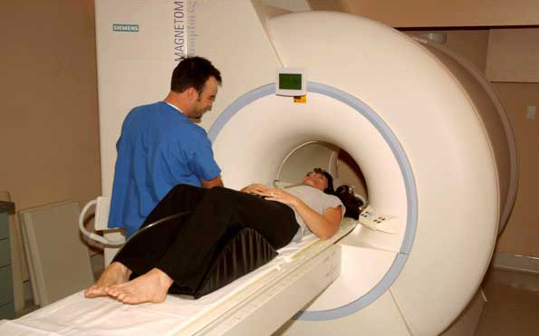
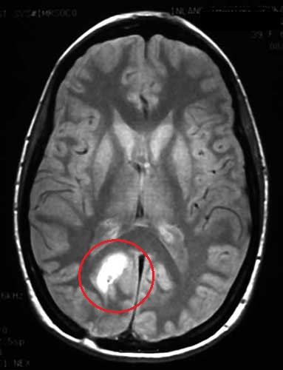
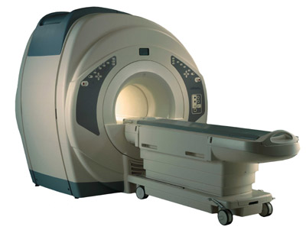
(M R I) Magnetic Resonance Imaging
Electric current produces magnetic field, even if the current is very weak.
Creating image
Tendency of a system to oscillate with greater amplitude at some frequency than at other
Ion current (very weak) which travels along the nerve cells in our body produces magnetic fields.
MRI machine used to diagnose diseases
Machine senses the magnetic field of the body
Patient is made to lie in the machine
If we touch something, our nerves carry an electrical, impulse to the muscles we need to use.
Impulse traveling from brain to organs
This produces weak magnetic field. Heart and brain are the two main organs where significant magnetic fields can be produced.
This forms the basis of obtaining images of heart and brain. This is done by using a technique called Magnetic Resonance Imagining (MRI).

Slide 9
Thank You

